Slide 1

SHEQ PROFESSIONALS FACE FAR MORE CHALLENGES THAN EVER BEFORE…
Auditors expect documents to be recorded and stored electronically.
Analysis and reporting demands are immense.
Now, it’s not just 16.2s who can be prosecuted, but also the 16.1! (Huge pressure on 16.2s)
Criminal charges and civil claims are on the increase.
With increasing online exposure, reputation damage is much more likely – Even disgruntled employees can do harm unfairly.
SHREQMANAGER IS DESIGNED TO HELP YOU TO ELIMINATE THESE CHALLENGES
STAR CYCLE

Slide 2
HERE’S HOW SHREQMANAGER WORKS ITS MAGIC…
STAR CYCLE

Slide 3
IT AUTOMATES THE SCHEDULING, TRACKING, ALERTING AND RESOLUTION OF WELL, EVERYTHING!!
WE CALL IT THE STAR CYCLE…
STAR CYCLE

Slide 4
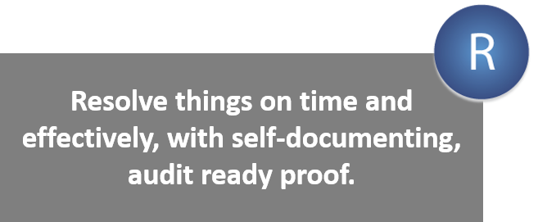
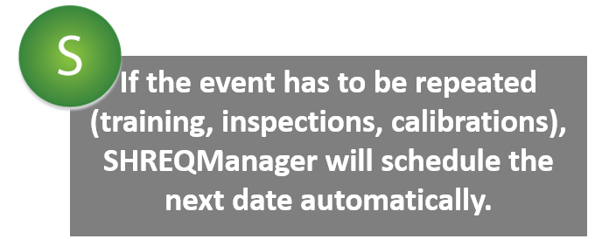
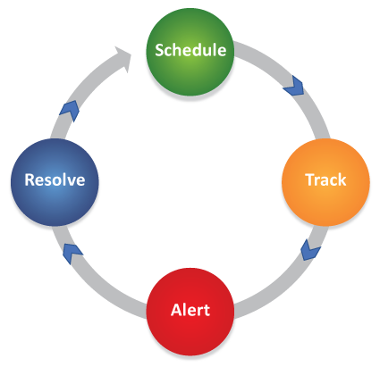
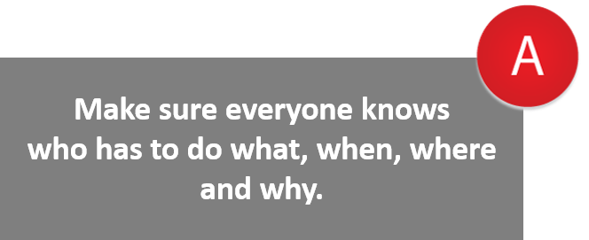

STAR CYCLE

Slide 5
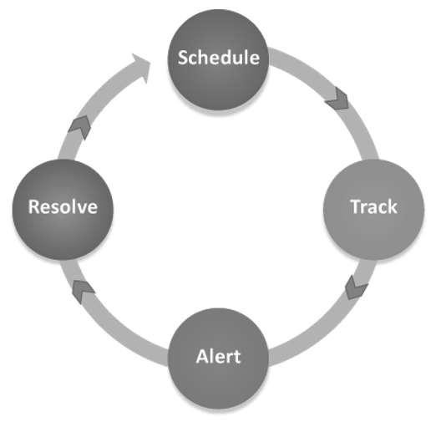
SCHEDULE
Here are some examples of what SHREQManager schedules and tracks for you:
Inspections
Calibrations
Training
Actions
Risk Assessments
Medicals
Tests
PPE Issuing
SCHEDULE

Slide 6
SCHEDULE
Inspections
Calibrations
Training
Actions
Risk Assessments
Medicals
Tests
PPE Issuing
SCHEDULE

Slide 7

You can then track all these events that have to happen.
But there are unexpected things that happen and require urgent attention
such as…
TRACK
Customer Complaints
Incidents
Investigations
Actions
SHREQManager also tracks these for you, no painful unpleasant surprises.
TRACK

Slide 8
TRACK
Customer Complaints
Incidents
Investigations
Actions
TRACK

Slide 9
SHREQManager also takes over the painful task of alerting all those responsible for carrying out these tasks by:
Generating reports for you to distribute
Sending automated email alerts
Displaying them on the employee dashboards
ALERT
ALERT

Slide 10
SHREQManager also takes over the painful task of alerting all those responsible for carrying out these tasks by:
Generating reports for you to distribute
Sending automated email alerts
Displaying them on the employee dashboards
ALERT
ALERT

Slide 11
RESOLVE
With SHREQManager you ensure nothing’s missed. You resolve everything and eliminate nasty surprises (and consequences).
Contact us for information on 031 764 1515 or email us at info@software1066.com to set up a demo.
RESOLVE

